Slide 1

CSE347
Information System Analysis and Design
Md Sabbir Hossain
Lecturer
Department of Computer Science and Engineering Faculty of Science and Engineering

Slide 2
Topic: 6
Activity Diagram

Slide 3
Activity Diagram
Activity diagrams describe the workflow behavior of a system.
Activity diagrams are used in process modeling and analysis of during requirements engineering.
A typical business process which synchronizes several external incoming events can be represented by activity diagrams.
They are most useful for understanding workflow analysis of synchronous behaviors across a process.

Slide 4
Activity Diagram
The diagrams describe the state of activities by showing the sequence of activities performed.
It helps to show activities that are conditional or parallel. Activity diagrams are used for-
Documenting existing process
Analyzing new process concepts Finding reengineering opportunities.

Slide 5
Activity Diagram Concepts
An activity is trigged by one or more events and activity may result in one or more events that may trigger other activity or processes.
Events start from start symbol and end with finish marker having activities in between connected by events.
The activity diagram represents the decisions, iterations and parallel/random behavior of the processing.

Slide 6
Components
An activity is an ongoing, though interruptible, execution of a step in a workflow (such as an operation or transaction)
Represented with a rounded rectangle.
Text in the activity box should represent an activity (verb phrase in present tense).
An event is triggered by an activity. It specifies a significant occurrence that has a location in time and space.
An instance of an event (trigger) results in the flow from one activity to another.
These are represented by directed straight lines emerging from triggering activity and ending at activity to be triggered. Label text for events should represent event but not the data involved.

Slide 7
Components
A decision may be shown by labeling multiple output transitions of an activity with different guard conditions.
For convenience a stereotype is provided for a decision: the traditional diamond shape, with one or more incoming arrows and with two or more outgoing arrows, each labeled by a distinct guard condition with no event trigger.

Slide 8
How to Draw an Activity Diagram
Diagrams are read from top to bottom and have branches and forks to describe conditions and parallel activities.
A fork is used when multiple activities are occurring at the same time.
A branch describes what activities will take place based on a set of conditions.
All branches at some point are followed by a merge to indicate the end of the conditional behavior started by that branch.
After the merge all of the parallel activities must be combined by a join before transitioning into the final activity state.

Slide 9

Use Case
Fixing Appointment
Sales Person
Taking Preparation
for Appointment
Conducting
Appointment
Corporate
Technician
Providing follow-up
Consultant
Confirming proposal

Slide 10
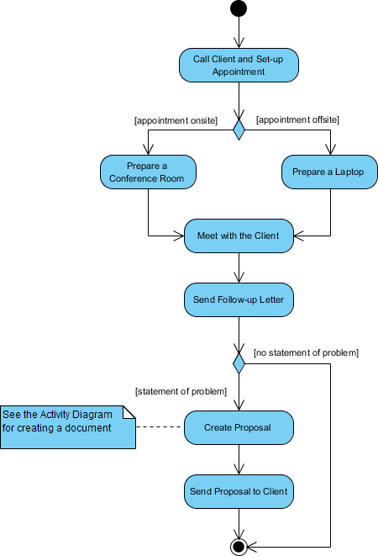
Activity Diagram Example
The activity diagram example below describes the business process for meeting a new client

Slide 11
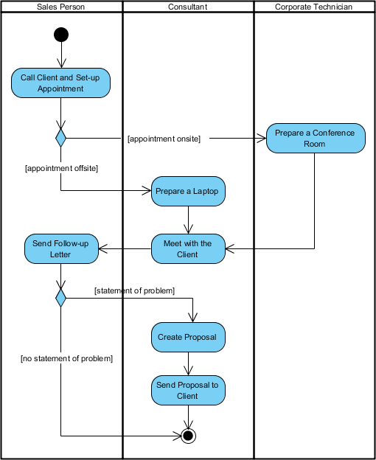
Activity Diagram Example
The activity diagram example below describes the business process for meeting a new client using an activity Diagram with swimlane.

Slide 12



Activity Diagram Notation Summary
Notation Description | UML Notation
Activity is used to represent a set of actions
Action is a task to be performed
Control Flow shows the sequence of execution
Object Flow shows the flow of an object from one activity (or action) to another activity (or action).
Initial Node portrays the beginning of a set of actions or activities
Activity Final Node stops all control flows and object flows in an activity (or action)
Object Node represents an object that is connected to a set of Object Flows | 12

Slide 13




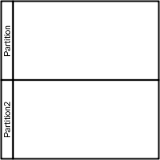
Activity Diagram Notation Summary
Notation Description | UML Notation
Decision Node represents a test condition to ensure that the control flow or object flow only goes down one path
Merge Node brings back together different decision paths that were created using a decision-node.
Fork Node splits behavior into a set of parallel or concurrent flows of activities (or actions)
Join Node brings back together a set of parallel or concurrent flows of activities (or actions).
Swimlane and Partition is a way to group activities performed by the same actor on an activity diagram or to group activities in a single thread

Slide 14
Advantages
Complex stage or steps in a software system can be explained easily diagrammatically.
Dynamic modeling of a software system.
Business processes and flows can be depicted easily.
The understanding of system requirements is explained in a lucid and simple manner.
The workflow of the user and the system and user with the system is explained in detail.

Slide 15
Disadvantages
The only drawback is the UML Activity Diagram is the messages or the communications between two components, or the user cannot be shown.

Slide 16
Example 1
A user wants to send a text message to his friend using a messaging app “WhatsDown”. User needs to log in to the software in order to do so. They need to select to whom they want to send the message first. Afterwards, they gets to write the desired text. They may attach any additional info to the message, such as- image, audio, video or any file within 20 mb.
They may edit the message within 50 seconds. User may delete the message anytime they want.

Slide 17
Example 2
In a snake game, a snake eats a food to get a point and increases length by one unit. After eating 5 foods it gets a bonus to eat. If it eats the bonus, it receives 10-point bonus, and the size of the snake reduces just as the first appearance. If it cannot eat the bonus within 10 seconds, the bonus disappears, and a virus appears within the premises. After another 20 seconds the virus also disappears.
The snake would be dead if it touches its tails or any virus.

